Slide 1
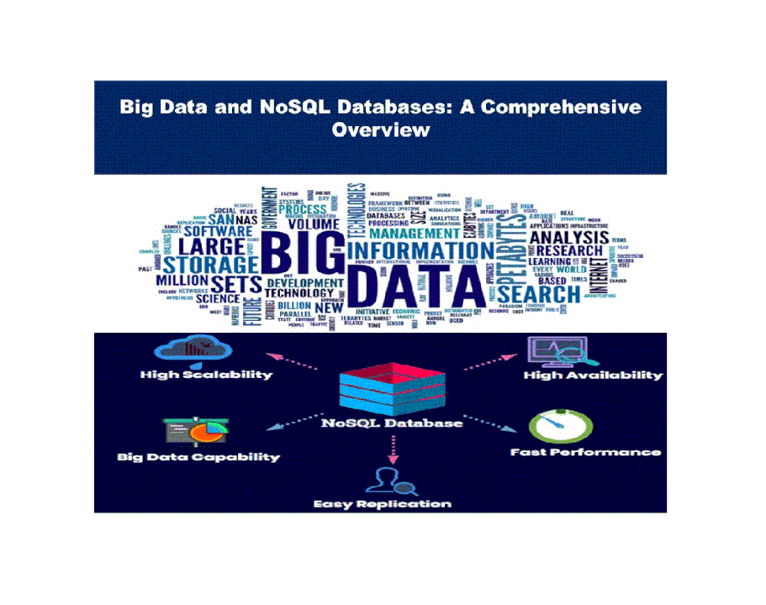
Module 3: NoSQL Big Data Management

Slide 2
Agenda
NoSQL Data Store
NoSQL Data Architecture Patterns
NoSQL to Manage Big Data
MongoDB
Examples

Slide 3
Why this topic is important?
There are more options that ever when building database applications. Good designers will select the right system for the project.
This topic will improve your development skills and provide experience with many different data systems.
Database systems management is a major research and commercial field.
The potential to produce new and exciting applications or research contributions is high. The group assignments will make you a better team member and communicator.
Data Engineering…

Slide 4
Introduction
The world of developers is probably divided into three groups when it comes to NoSQL:
Those who love it
Those who deny it
Those who ignore it
NoSQL is literally a combination of two words: No and SQL
NoSQL people probably wanted to say No RDBMS or No relational
NoSQL is actually an acronym that expands to “Not Only SQL”
Whatever the literal meaning, NoSQL is used today as an umbrella term for all databases and data stores that don’t follow the popular and well established RDBMS principles and often relate to large data sets accessed and manipulated on a Web scale.

Slide 5
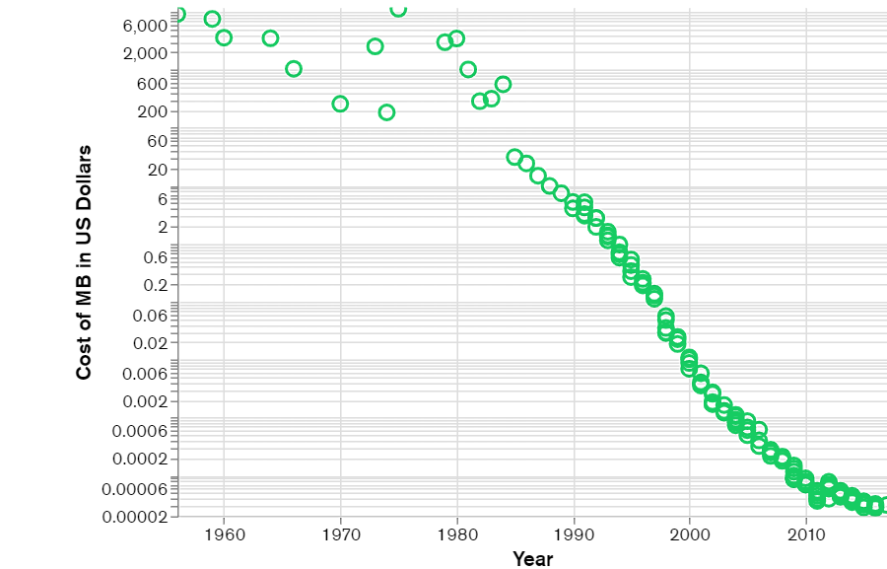
Contd…
NoSQL databases emerged in the late 2000s
This data came in all shapes and sizes —structured, semi-structured, and polymorphic — and defining the schema in advance became nearly impossible.
NoSQL databases allow developers to store huge amounts of unstructured data.

Slide 6
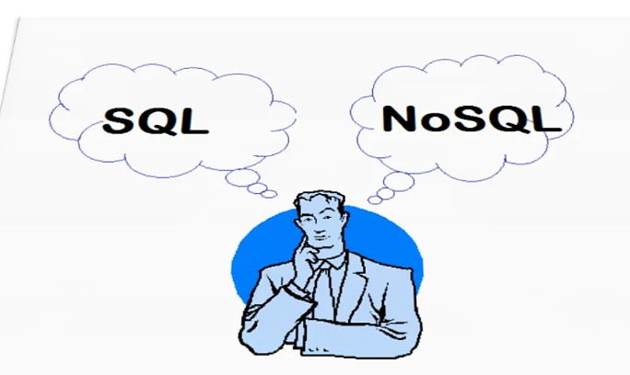
SQL vs. NoSQL

Slide 7
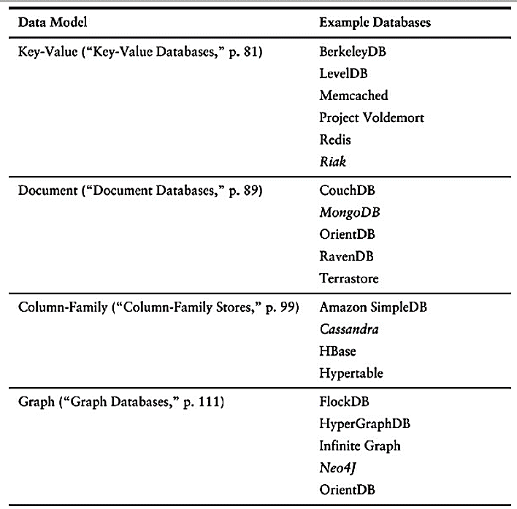
NoSQL Databases
Amazon DynamoDB :
Key-Value and Document Database

Slide 8
Characteristics of NoSQL databases
Not using the relational model
Running well on clusters
Open-source
Built for the 21st century web estates
Schemaless
Flexibility
Scalability
Horizontal scaling
Fast queries due to the data model
Ease of use for developers

Slide 9
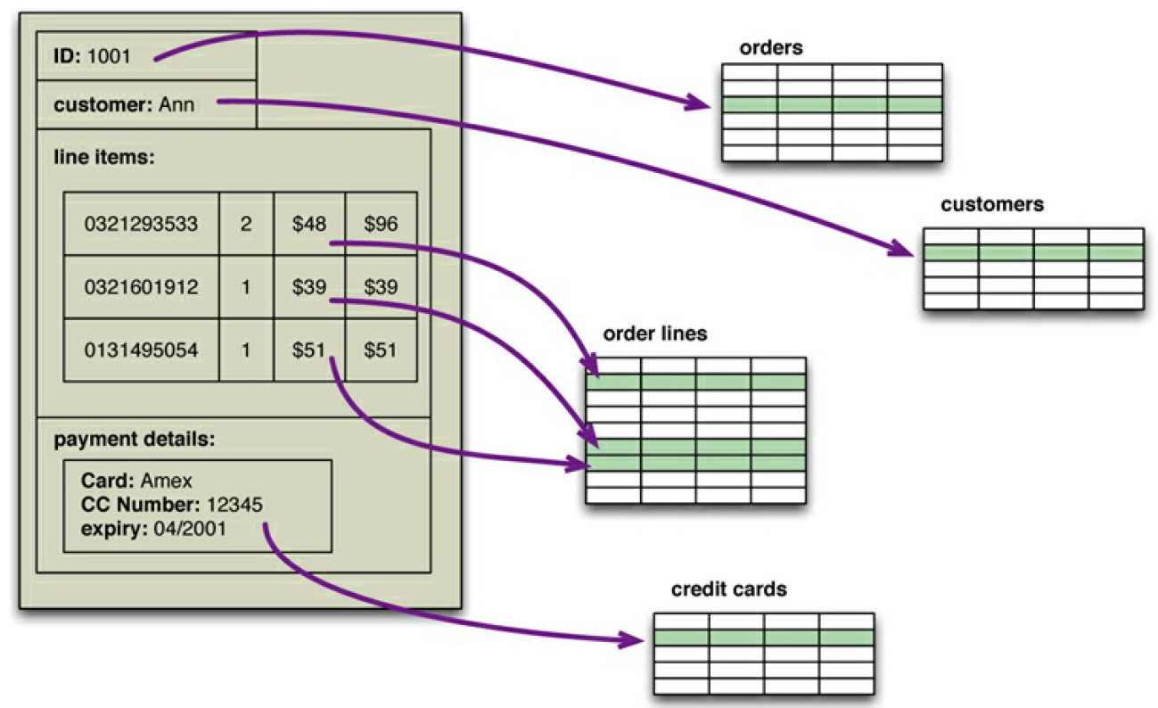
Example
An order, which looks like a single aggregate structure in the UI, is split into many rows from many tables in a relational database

Slide 10
The Emergence of NoSQL
The term “NoSQL” first made its appearance in the late 90s as the name of an open-source relational database [Strozzi NoSQL].
Led by Carlo Strozzi, this database stores its tables as ASCII files, each tuple represented by a line with fields separated by tabs.
The name comes from the fact that the database doesn’t use SQL as a query language.
Cassandra’s CQL is like this—“exactly like SQL (except where it’s not)”
Most NoSQL databases are driven by the need to run on clusters
Graph databases are one style of NoSQL databases - uses a distribution model similar to relational databases but offers a different data model that makes it better at handling data with complex relationships.

Slide 11
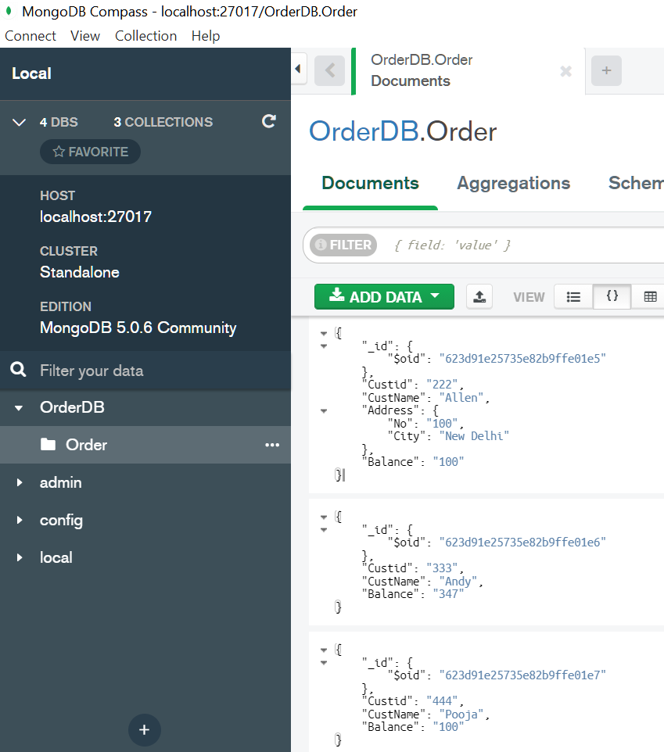
Contd…
NoSQL databases are generally based on the needs of the early 21st century web estates
NoSQL databases operate without a schema

Slide 12
What is NoSQL?
When you first hear “NoSQL,” an immediate question is what does it stand for—a “no” to SQL?
Most people who talk about NoSQL say that it really means “Not Only SQL,” but this interpretation has a couple of problems
polyglot persistence - Polyglot Persistence means that when storing data, it is best to use multiple data storage technologies, chosen based upon the way data is being used by individual applications or components of a single application.

Slide 13
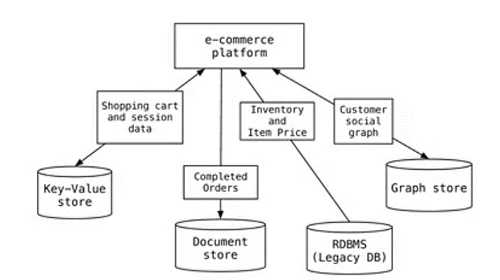
Example

Slide 14
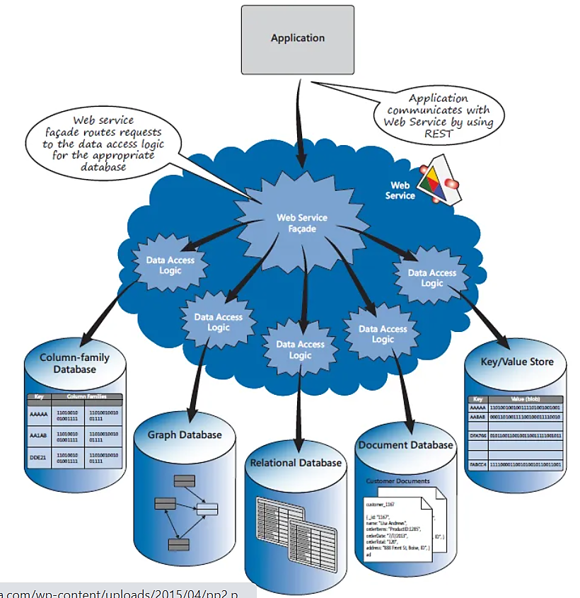
Web Services for Polyglot
With an application that uses many types of data, a web service can be created to send the data request to the appropriate database:

Slide 15
When should NoSQL be used?
Fast-paced Agile development
Storage of structured and semi-structured data
Huge volumes of data
Requirements for scale-out architecture
Modern application paradigms like micro-services and real-time streaming

Slide 16
CAP Theorem
Brewer's CAP (Consistency, Availability and Partition Tolerance) theorem demonstrates that any distributed system cannot guarantee C, A and P together.
Consistency- All nodes observe the same data at the same time.
Availability- Each request receives a response on success/failure.
Partition Tolerance-The system continues to operate as a whole even in case of message loss, node failure or node not reachable.

Slide 17
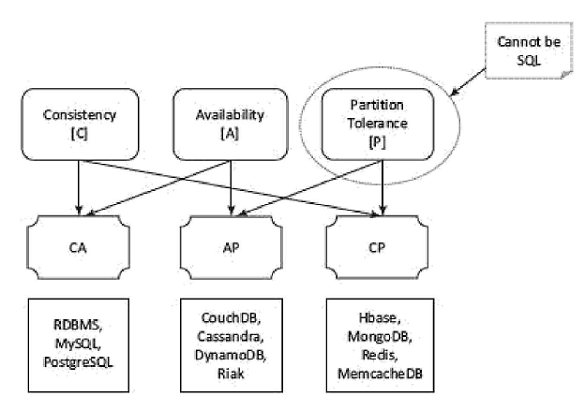
CAP Theorem in Big Data

Slide 18
Schema-less Models
Schema - structure for datasets and data structures for storing into the database.
NoSQL data not necessarily have a fixed table schema.
No Joins (between distributed datasets).
A cluster-based highly distributed node manages a single large data store with a NoSQL DB.
Data written at one node replicates to multiple nodes.
Therefore, these are identical, fault-tolerant and partitioned into shards.
Distributed databases can store and process a set of information on more than one computing nodes.

Slide 19
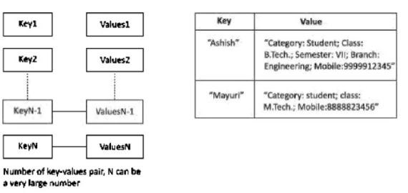
NoSQL Data Architecture Patterns
1. Key-Value Store
A simple string called, key maps to a large data string or BLOB (Basic Large Object).
Key-value store accesses use a primary key for accessing the values.
Therefore, the store can be easily scaled up for very large data.
The concept is similar to a hash table where a unique key points to a particular item(s) of data.

Slide 20
Advantages of a key-value Store
Data Store can store any data type in a value field.
A query just requests the values and returns the values as a single item.
Key-value store is eventually consistent.
Key-value data store may be hierarchical or may be ordered key-value store.
Returned values on queries can be used to convert into lists, table­ columns, data-frame fields and columns.
Have (i) scalability, (ii) reliability, (iii) portability and (iv) low operational cost.
The key can be synthetic or auto-generated

Slide 21
Document Data Store
Data storage system designed for storing, retrieving and managing document-oriented information, also known as semi-structured data.
It is a sub-class of key-value store.
The central concept of a document-oriented database is the notion of a document.
While each document-oriented database implementation differs on the details of this definition – JSON, BSON, XML, etc.

Slide 22
Example - MongoDB
Model One-to-One Relationships with Embedded Documents
// patron document
{
_id: "joe",
name: "Joe Bookreader"
}
// address document
{
patron_id: "joe", // reference to patron document
street: "123 Fake Street",
city: "Faketon",
state: "MA",
zip: "12345"
}
{
_id: "joe",
name: "Joe Bookreader",
address: {
street: "123 Fake Street",
city: "Faketon",
state: "MA",
zip: "12345"
}
}
If the address data is frequently retrieved with the name information, then with referencing, your application needs to issue multiple queries to resolve the reference.
The better data model would be to embed the address data in the patron data

Slide 23
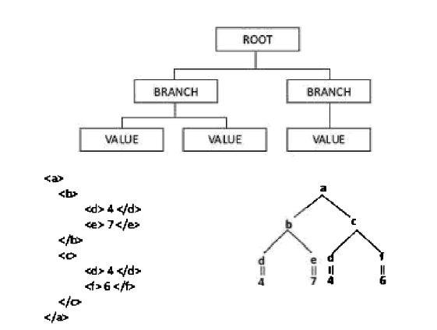
XML
Document Architecture Pattern and Discovering Hierarchical Structure

Slide 24
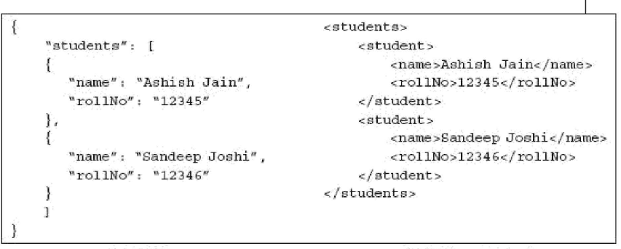
XML and JSON

Slide 25
Tabular Data
Tabular data stores use rows and columns.
Row-head field may be used as a key which access and retrieves multiple values from the successive columns in that row.
The OLTP is fast on in-memory row-format data.
Oracle, MySQL, etc.

Slide 26
Column Family Data Store
It has a group of columns as a column family.
A combination of row-head, column-family head and table­ column head can also be a key to access a field in a column of the table during querying.
All values in successive fields in a column consisting of multiple rows save at consecutive memory addresses.
This enables fast accesses during in-memory analytics.
Examples of columnar family data stores are HBase, BigTable, HyperTable and Cassandra.

Slide 27
Example
Data for a large number of ACVMs with an ACVM_ID each, store in column 1.
Data for each day sales at each ACVM for KitKat, Milk, Fruit and Nuts, Nougat and Oreo store in Columns 2 to 6.
Each row has six cells (ID +five sales data).
How do the column key values store in memory?
How do the values store in the memory in columnar storage format?

Slide 28
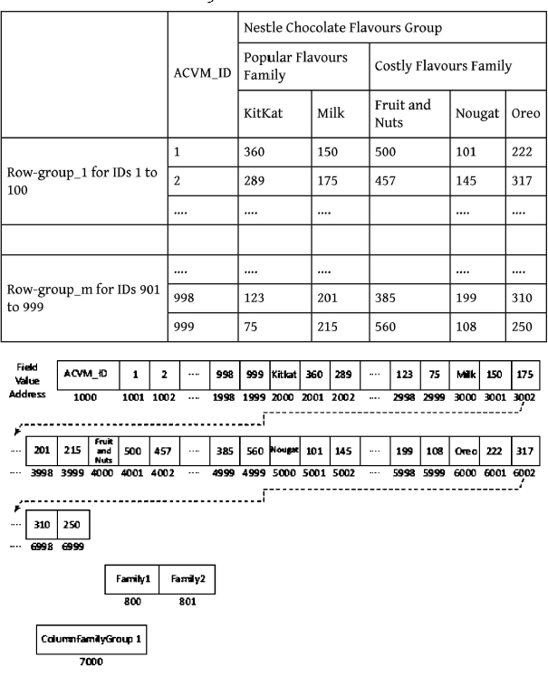
Solution
keys for row groups
two column families
keys for column families

Slide 29
Object Data Store
An object store refers to a repository which stores the:
Objects (such as files, images, documents, folders, and business reports)
System metadata which provides information such as filename, creation_date, last_modified, language_used (such as Java, C, C#, C++, Smalltalk, Python), access_permissions, supported query languages)
Custom metadata which provides information, such as subject, category, sharing permissions.
Amazon S3 and Microsoft Azure BLOB support the Object Store.

Slide 30
Amazon S3
Amazon Simple Storage Service (Amazon S3) is an object storage service that offers industry-leading scalability, data availability, security, and performance.
Amazon S3 is used to store and protect any amount of data for a range of use cases, such as
data lakes
Websites
mobile applications
backup and restore
Archive
enterprise applications
IoT devices
big data analytics.

Slide 31
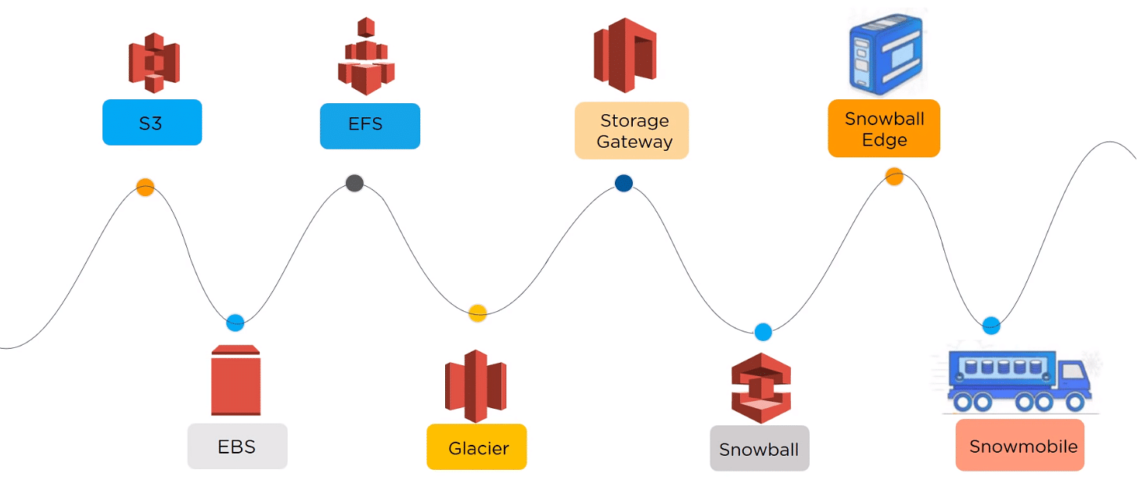
Storage services offered by Amazon

Slide 32

AWS Buckets and Objects
An object consists of data, key (assigned name), and metadata.
A bucket is used to store objects.
When data is added to a bucket, Amazon S3 creates a unique version ID and allocates it to the object.

Slide 33
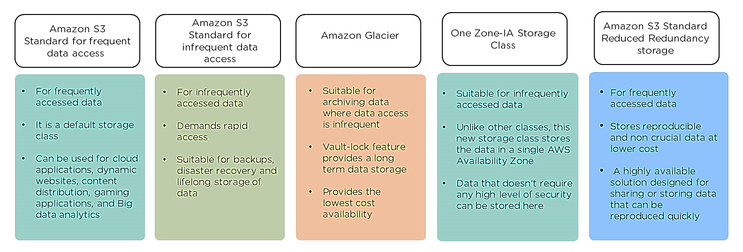
Storage classes

Slide 34

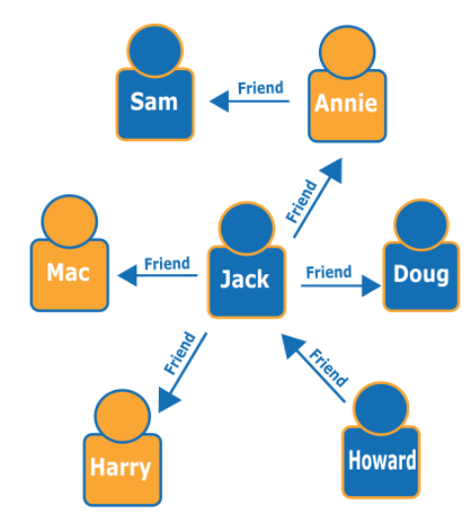
Graph Databases
Graph databases are to store and navigate relationships.
Graph databases use nodes to store data entities, and edges to store relationships between entities.
An edge always has a start node, end node, type, and direction, and an edge can describe parent-child relationships, actions, ownership, and the like.
There is no limit to the number and kind of relationships a node can have.

Slide 35
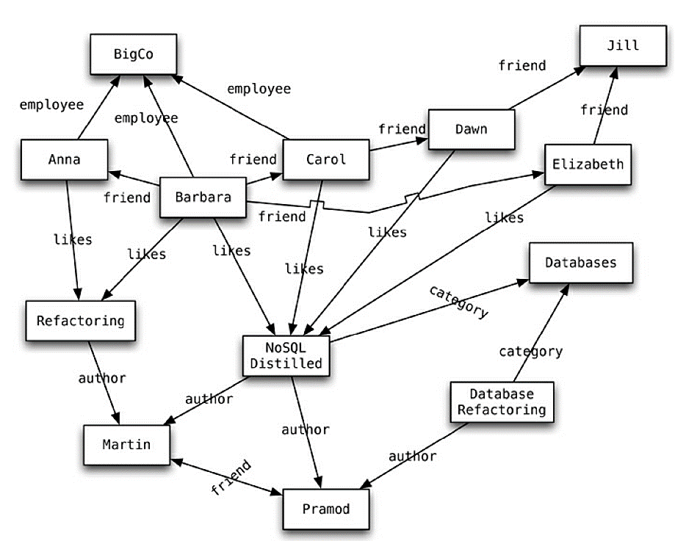
Contd.
Most NoSQL databases were inspired by the need to run on clusters, which led to aggregate-oriented data models of large records with simple connections.
Graph databases are motivated by a different frustration with relational databases and thus have an opposite model—small records with complex interconnections

Slide 36
Queries
Query: “find the books in the Databases category that are written by someone whom a friend of mine likes.”
Uses cases: capturing any data consisting of complex relationships such as social networks, product preferences, or eligibility rules, fraud detection, etc.
Ex: FlockDB, Neo4J
RDBMS – relationships through FK, More Joins, etc.
Graph DB - make traversal along the relationships - very cheap
Query: “tell me all the things that both Anna and Barbara like.”
Find the nodes with IDs and navigate via edges

Slide 37
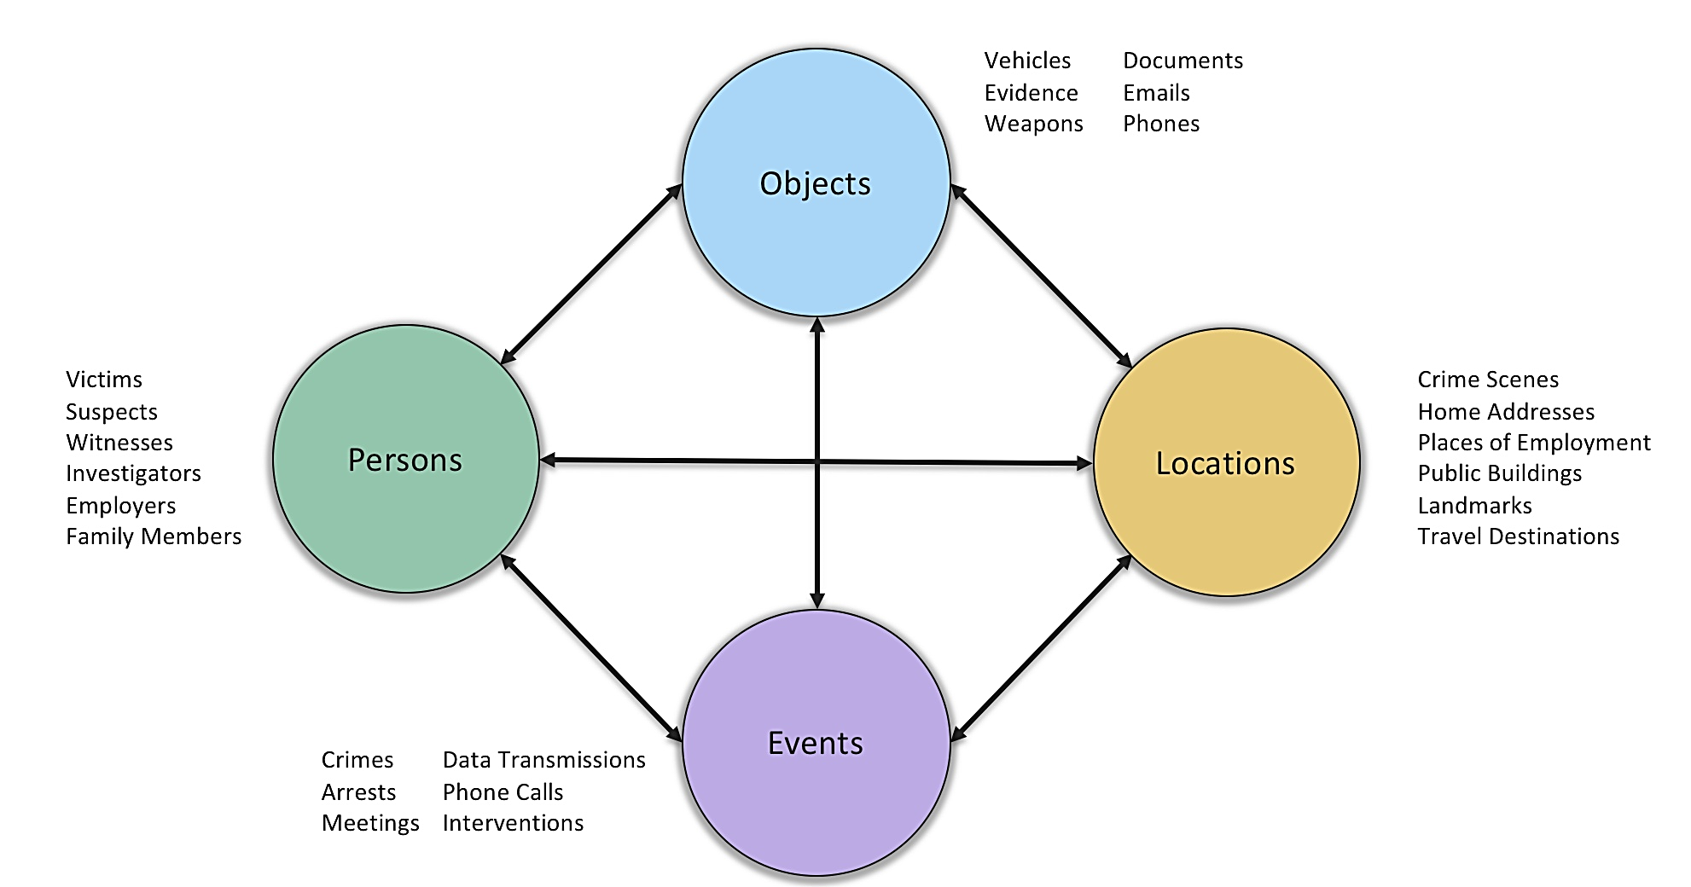
Neo4J Graph Database (Crime Investigation)

Slide 38
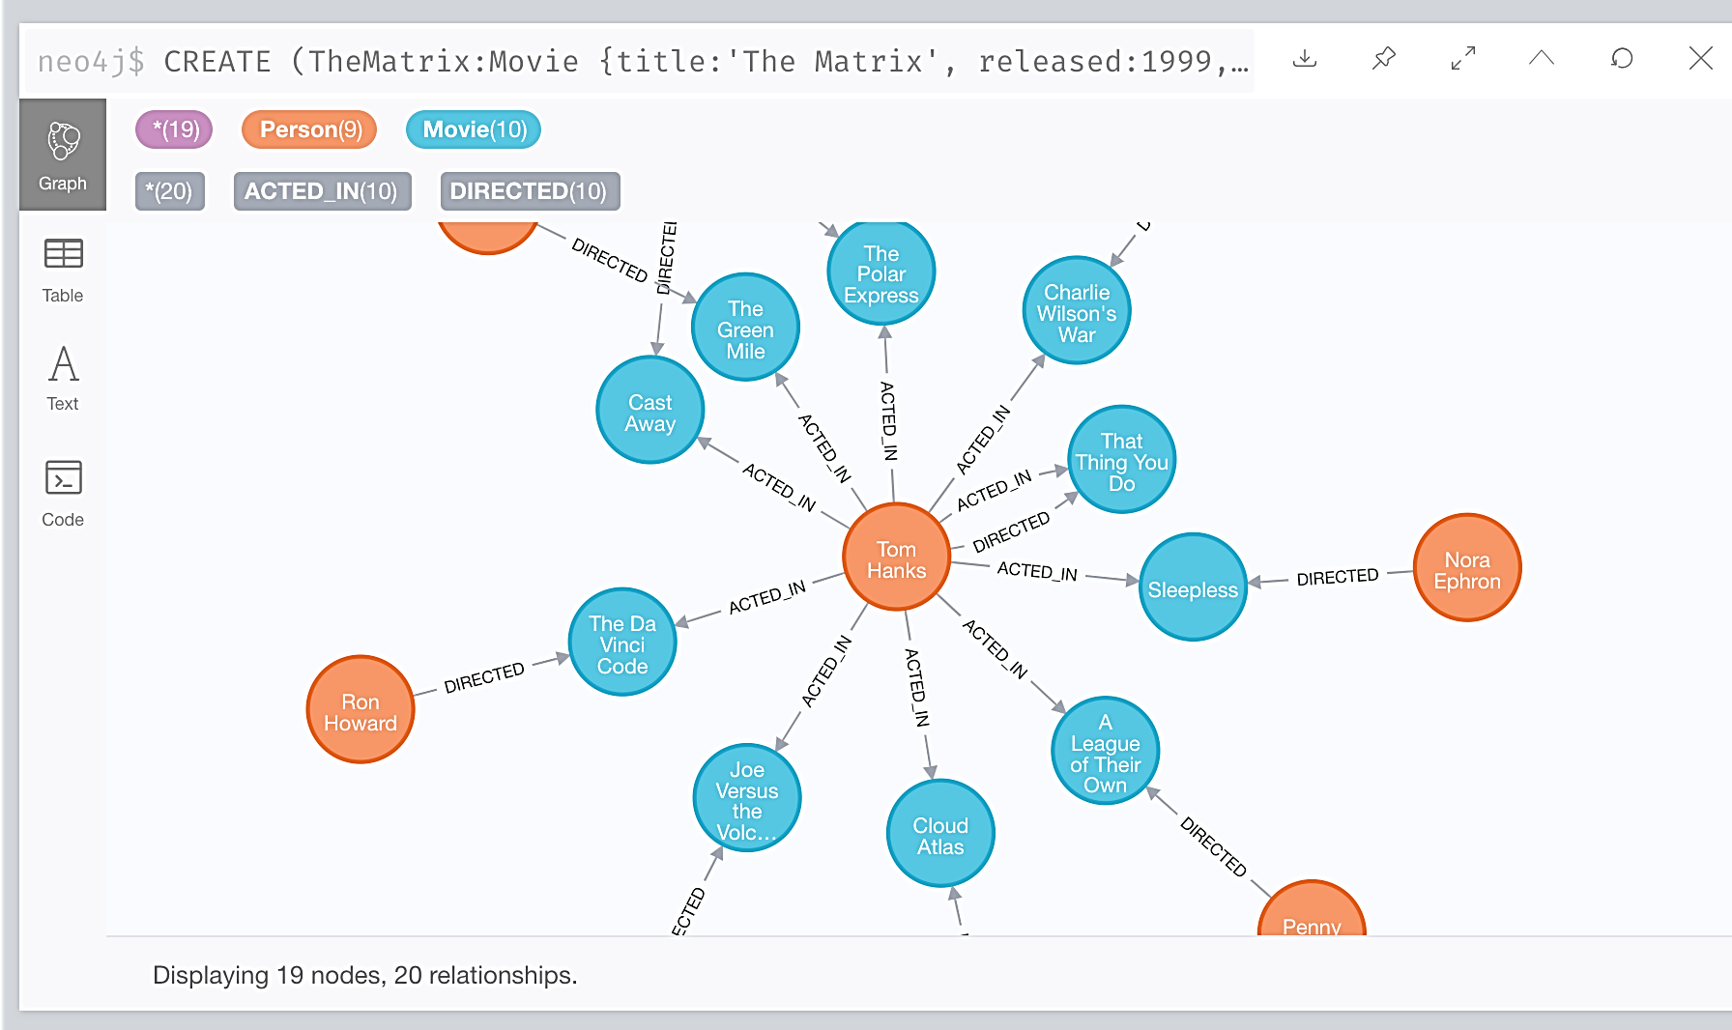
Movie DB
https://neo4j.com/docs/getting-started/appendix/tutorials/guide-cypher-basics/

Slide 39
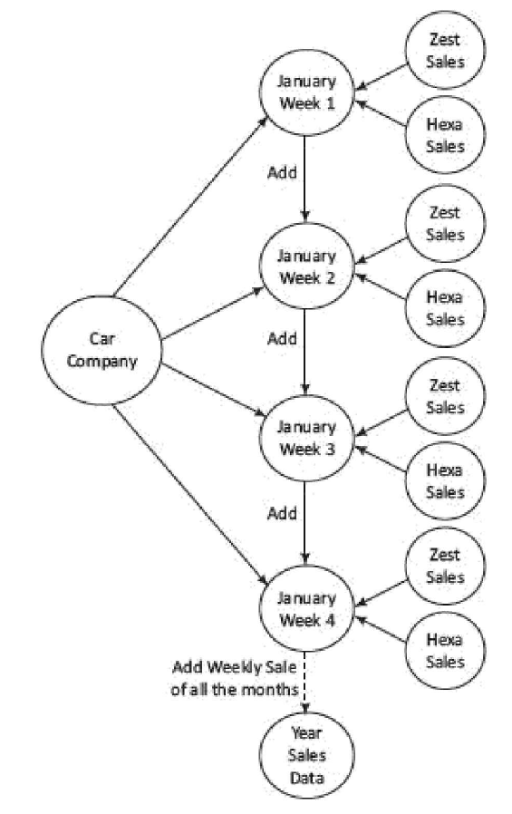
Exercise
Assume a car company represents a node entity, which has two connected nodes comprising two model entities, namely Hexa and Zest.
Draw a graph with directed lines, joining the car company with two entities. (i) How do four directed lines relate to four weeks and two directed lines? One directed line corresponds to a car model. Only directed line corresponds to weekly total sales.

Slide 40
NoSQL to Manage Big Data
NoSQL
(i) limits the support for Join queries, supports sparse matrix like columnar-family,
(ii) characteristics of easy creation and high processing speed,
(iii) scalability and storability of much higher magnitude of data (terabytes and petabytes).
NoSQL sacrifices the support of ACID properties, but provides CAP

Slide 41
Characteristics of Big Data NoSQL solution
High and easy scalability
Support to replication
Distributable
Cheaper NoSQL Servers
Open-source tools
Support to schema-less
Support to integrated cachingdata model

Slide 42
MongoDB
MongoDB is a (i) non-relational, (ii) NoSQL, (iii) distributed, (iv) open source, (v) document based, (vi) cross-platform, (vii) Scalable, (viii) flexible data model, (ix) Indexed, (x) multi-master, and (xi) fault tolerant.
Document data store in JSON-like documents. The data store uses the dynamic schemas.
Applications: content management and delivery systems, mobile applications, user data management, gaming, e-commerce, analytics, archiving and logging.
Collection stores a number of MongoDB documents. It is analogous to a table of RDBMS.

Slide 43
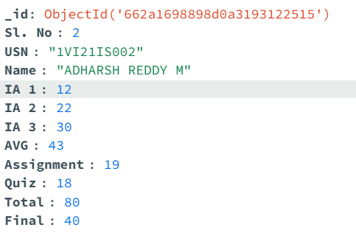
Commands-Create
dbms database name database
dbmsmarks table collection (of documents)
record row document
const database = 'Sales';
const collection = 'Customer';
use(database);
db.createCollection(collection);

Slide 44
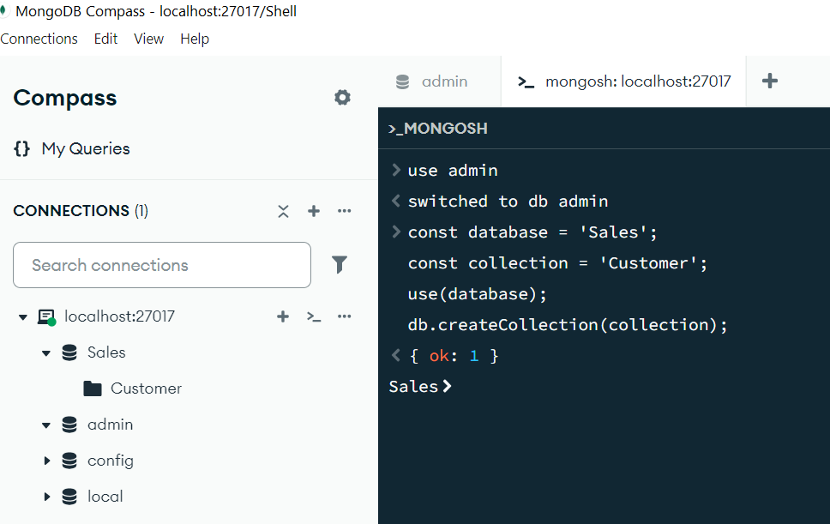
Create…

Slide 45
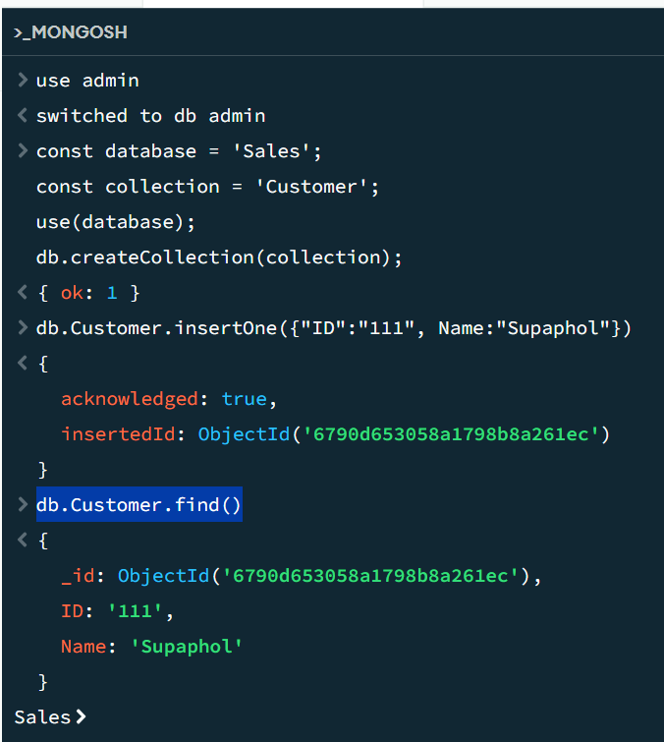
Insert one Row
To insert one row to a collection, use the below command
>db.Customer.insertOne({"ID":"111", Name:"Supaphol"})
Next to display all documents, type the below command:
>db.Customer.find()

Slide 46
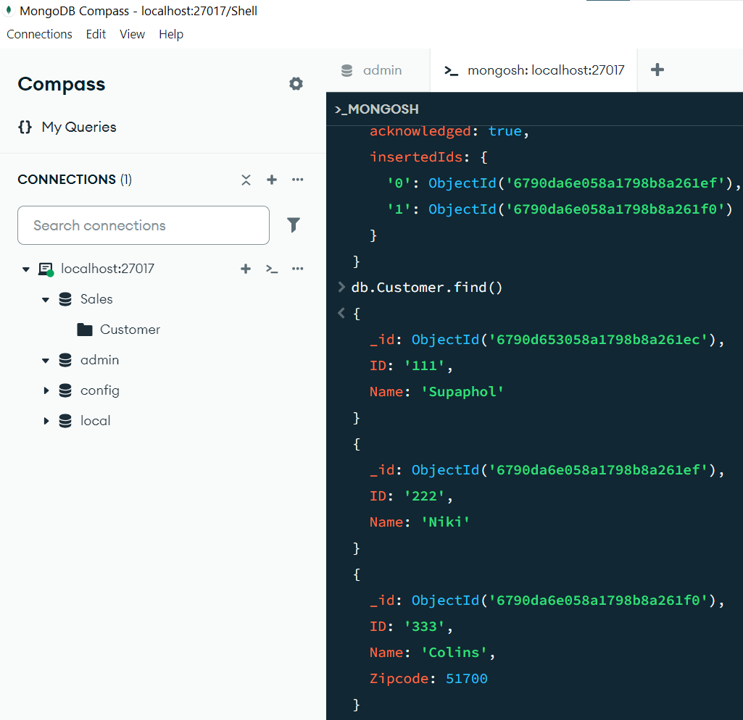
Insert Many Rows
To insert many rows, use the following command:
db.Customer.insertMany([{"ID":"222", Name:"Niki"}, {"ID":"333", Name:"Colins", "Zipcode":51700}])

Slide 47
Retrieve
>db.Customer.find()
# finds all documents in the collection
>db.dbmsmarks.find().count() # total no. of rows
>cls # clear the screen
Insert another document with the same Zipcode 51700
>db.Customer.insertOne({"ID":"444", Name:"John", Zipcode:51700})
# Find all documents where Zipcode = 51700
>db.Customer.find( { Zipcode: { $eq: 51700 } } )
Here $eq is a conditional operator. Similarly, we can use $gt, $lt, etc.

Slide 48
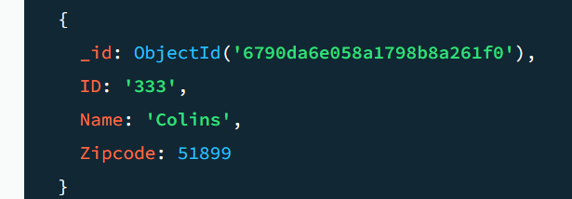
Update
# update a document
>db.Customer.updateOne({Name:"Colins"},{$set:{"Zipcode":51899}})

Slide 49
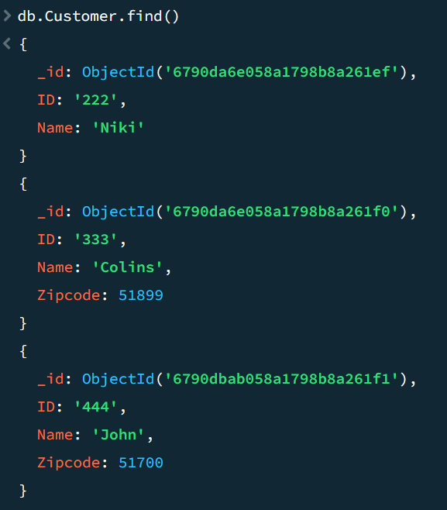
Delete
# delete all documents
>db.Customer.deleteMany()
# delete one document
>db.Customer.deleteOne({"ID":"111"})

Slide 50
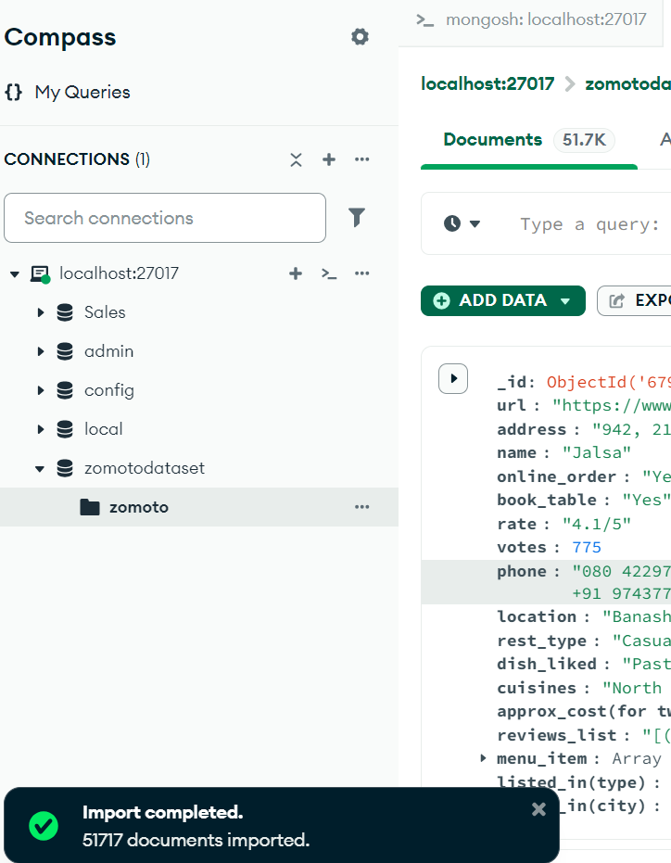
Exercise
Import a large dataset from internet and load it into MongoDB and show some useful manipulations.
Download Zomoto Restaurant (Bangalore, India) from kaggle.
https://www.kaggle.com/datasets/himanshupoddar/zomato-bangalore-restaurants?resource=down

Slide 51
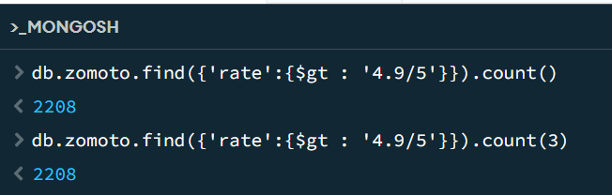
Query the Zomoto DB
Count number of documents whose rating is greater than 4.9/5

Slide 52
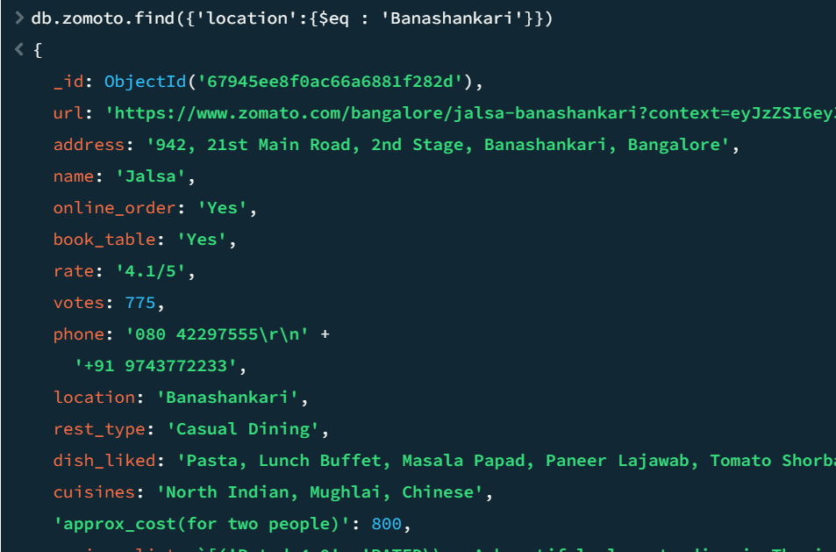
Find Restaurants in Banashankari

Slide 53
Map-Reduce Example
Create a sample collection orders with these documents:
db.orders.insertMany([
{ _id: 1, cust_id: "Ant O. Knee", ord_date: new Date("2020-03-01"), price: 25, items: [ { sku: "oranges", qty: 5, price: 2.5 }, { sku: "apples", qty: 5, price: 2.5 } ], status: "A" },
{ _id: 2, cust_id: "Ant O. Knee", ord_date: new Date("2020-03-08"), price: 70, items: [ { sku: "oranges", qty: 8, price: 2.5 }, { sku: "chocolates", qty: 5, price: 10 } ], status: "A" },
{ _id: 3, cust_id: "Busby Bee", ord_date: new Date("2020-03-08"), price: 50, items: [ { sku: "oranges", qty: 10, price: 2.5 }, { sku: "pears", qty: 10, price: 2.5 } ], status: "A" },
{ _id: 4, cust_id: "Busby Bee", ord_date: new Date("2020-03-18"), price: 25, items: [ { sku: "oranges", qty: 10, price: 2.5 } ], status: "A" },
{ _id: 5, cust_id: "Busby Bee", ord_date: new Date("2020-03-19"), price: 50, items: [ { sku: "chocolates", qty: 5, price: 10 } ], status: "A"},
{ _id: 6, cust_id: "Cam Elot", ord_date: new Date("2020-03-19"), price: 35, items: [ { sku: "carrots", qty: 10, price: 1.0 }, { sku: "apples", qty: 10, price: 2.5 } ], status: "A" },
{ _id: 7, cust_id: "Cam Elot", ord_date: new Date("2020-03-20"), price: 25, items: [ { sku: "oranges", qty: 10, price: 2.5 } ], status: "A" },
{ _id: 8, cust_id: "Don Quis", ord_date: new Date("2020-03-20"), price: 75, items: [ { sku: "chocolates", qty: 5, price: 10 }, { sku: "apples", qty: 10, price: 2.5 } ], status: "A" },
{ _id: 9, cust_id: "Don Quis", ord_date: new Date("2020-03-20"), price: 55, items: [ { sku: "carrots", qty: 5, price: 1.0 }, { sku: "apples", qty: 10, price: 2.5 }, { sku: "oranges", qty: 10, price: 2.5 } ], status: "A" },
{ _id: 10, cust_id: "Don Quis", ord_date: new Date("2020-03-23"), price: 25, items: [ { sku: "oranges", qty: 10, price: 2.5 } ], status: "A" }
])

Slide 54
Return the Total Price Per Customer
Perform the map-reduce operation on the orders collection to group by the cust_id, and calculate the sum of the price for each cust_id:
Define the map function to process each input document:
In the function, this refers to the document that the map-reduce operation is processing.
The function maps the price to the cust_id for each document and emits the cust_id and price.
>var mapFunction1 = function() {
emit(this.cust_id, this.price);
};

Slide 55
Step 2
Define the corresponding reduce function with two arguments keyCustId and valuesPrices:
The valuesPrices is an array whose elements are the price values emitted by the map function and grouped by keyCustId.
The function reduces the valuesPrices array to the sum of its elements.
>var reduceFunction1 = function(keyCustId, valuesPrices) {
return Array.sum(valuesPrices);
};

Slide 56
Step 3
Perform map-reduce on all documents in the orders collection using the mapFunction1 map function and the reduceFunction1 reduce function:
>db.orders.mapReduce(
mapFunction1,
reduceFunction1,
{ out: "map_reduce_example" }
)

Slide 57
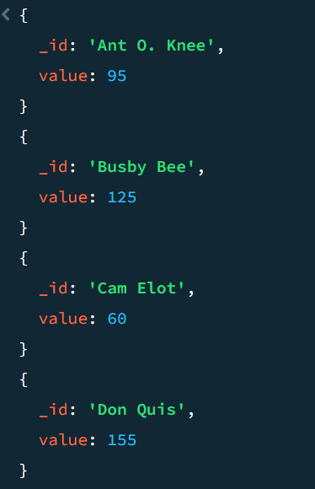
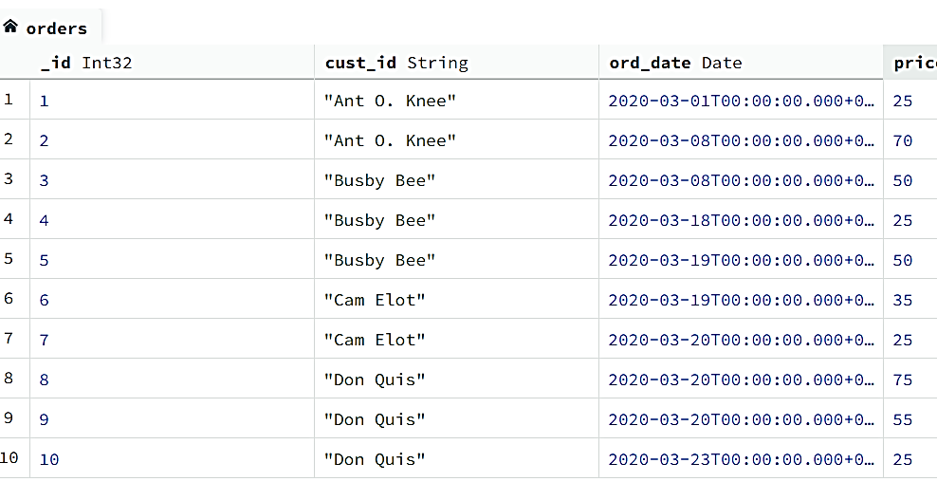
Step 4
Query the map_reduce_example collection to verify the results:
>db.map_reduce_example.find().sort( { _id: 1 } )

Slide 58
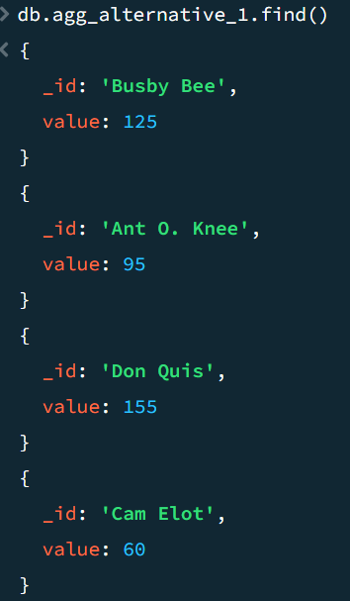
Alternative Method – using $group
db.orders.aggregate([
{ $group: { _id: "$cust_id", value: { $sum: "$price" } } },
{ $out: "agg_alternative_1" }
])
The $group stage groups by the cust_id and calculates the value field
The value field contains the total price for each cust_id.
{ "_id" : "Don Quis", "value" : 155 }
{ "_id" : "Ant O. Knee", "value" : 95 }
{ "_id" : "Cam Elot", "value" : 60 }
{ "_id" : "Busby Bee", "value" : 125 }

Slide 59
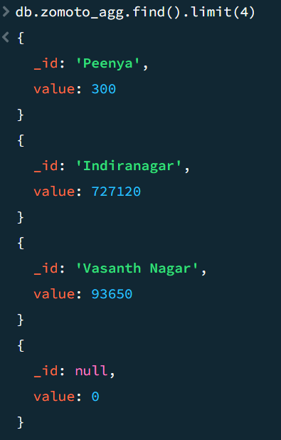
Zomoto Aggregate
db.zomoto.aggregate([
{ $group: { _id: "$location", value: {
$sum: "$approx_cost(for two people)"
} } },
{ $out: "zomoto_agg" }
])

Slide 60
Thank You

